Slide 1
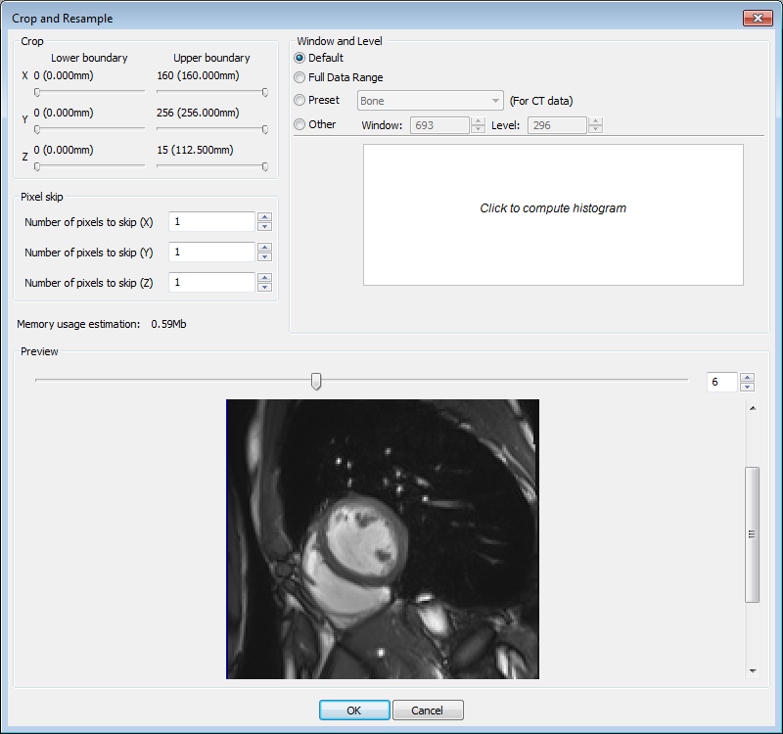
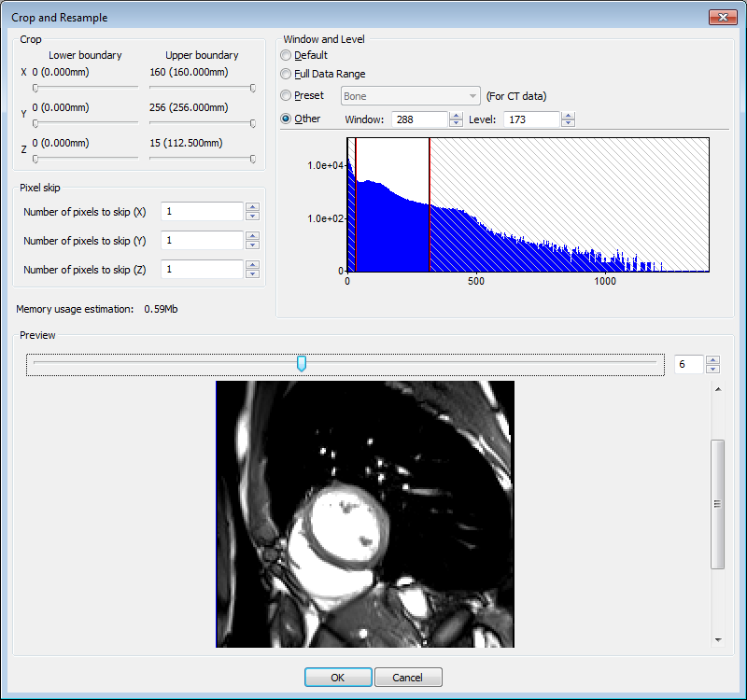

1) Importing image data.
MRI is the most difficult modality to work with as the soft tissue structures are all similar shades of grey. The trick is to window the image on import to make the structure of interest as clear from its surrounding as possible. Do this by clicking on the ‘View Histogram’ box and moving the red bars until the preview looks good....
Finding the right numbers is a matter of judgement. If you are unhappy with it you can reimport an additional background image to the file through Data-> Import -> Background ... ScanIP will let you have multiple backgrounds (so long as they are the same image dimensions) in any file and you can change between them by selecting them as you would between masks.

Slide 2
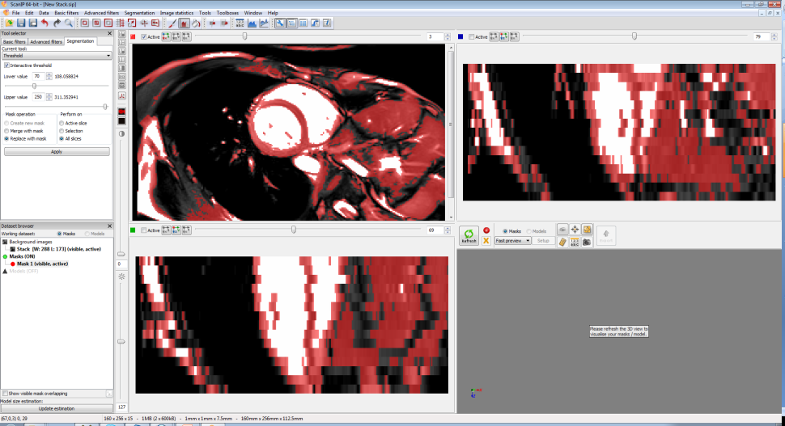
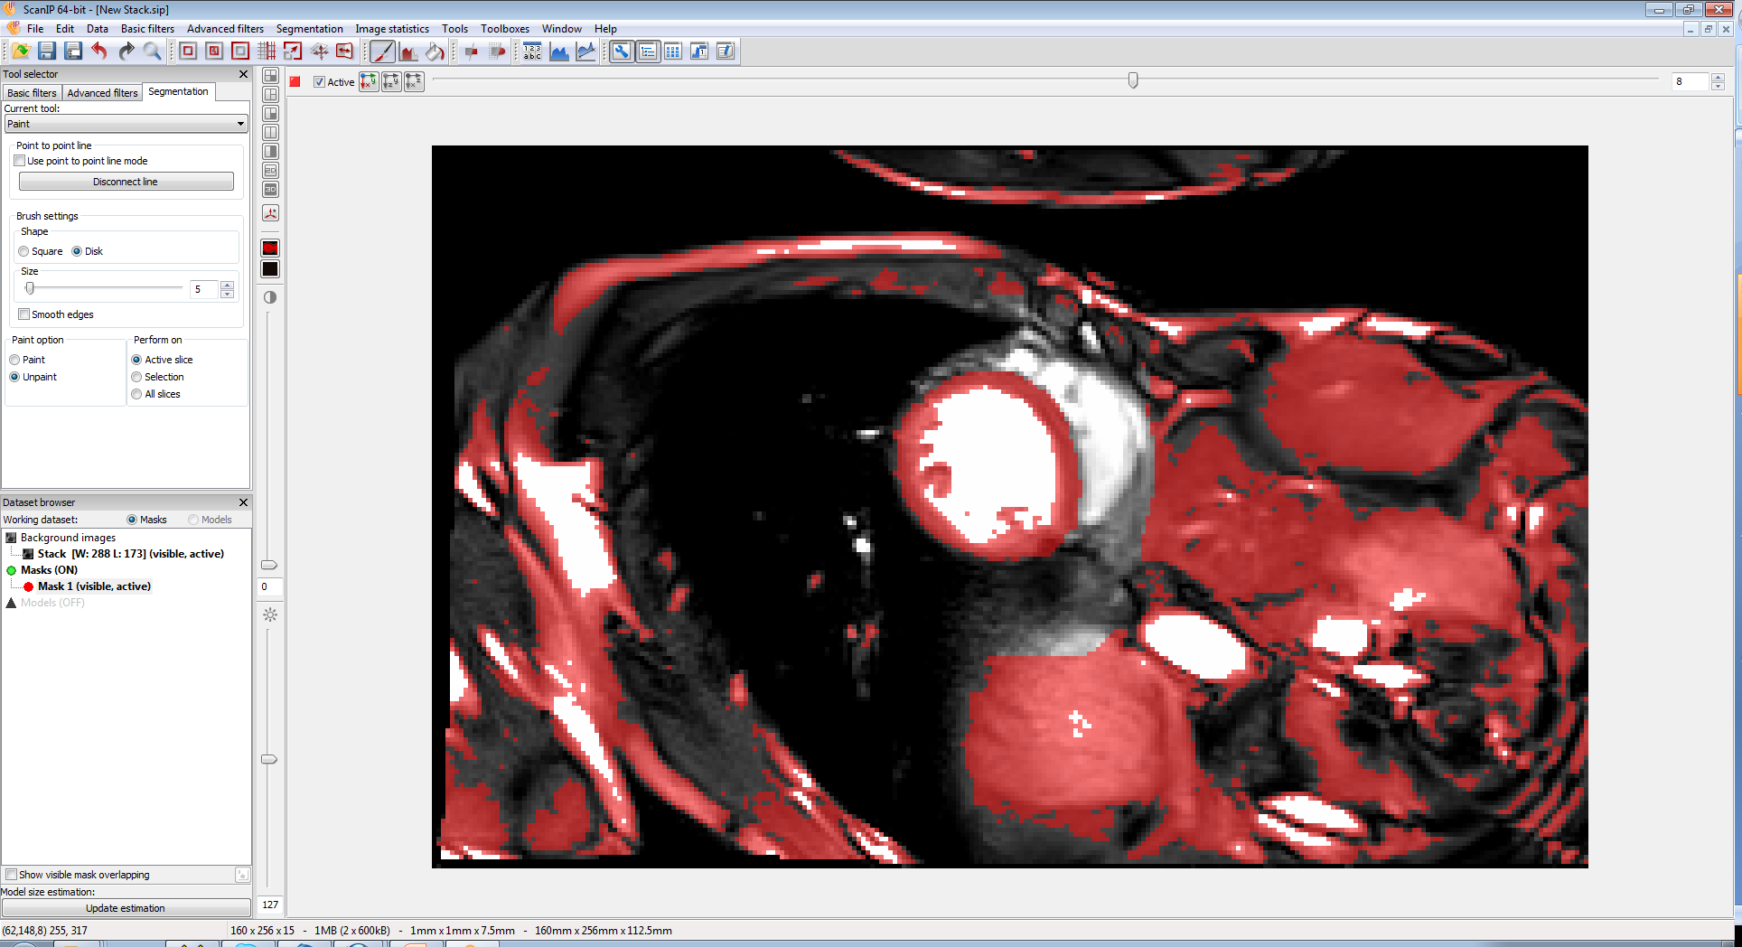
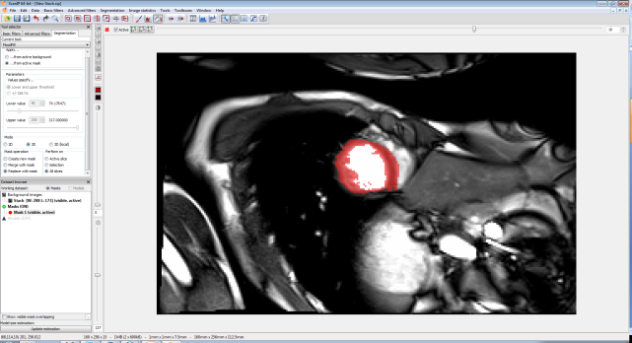
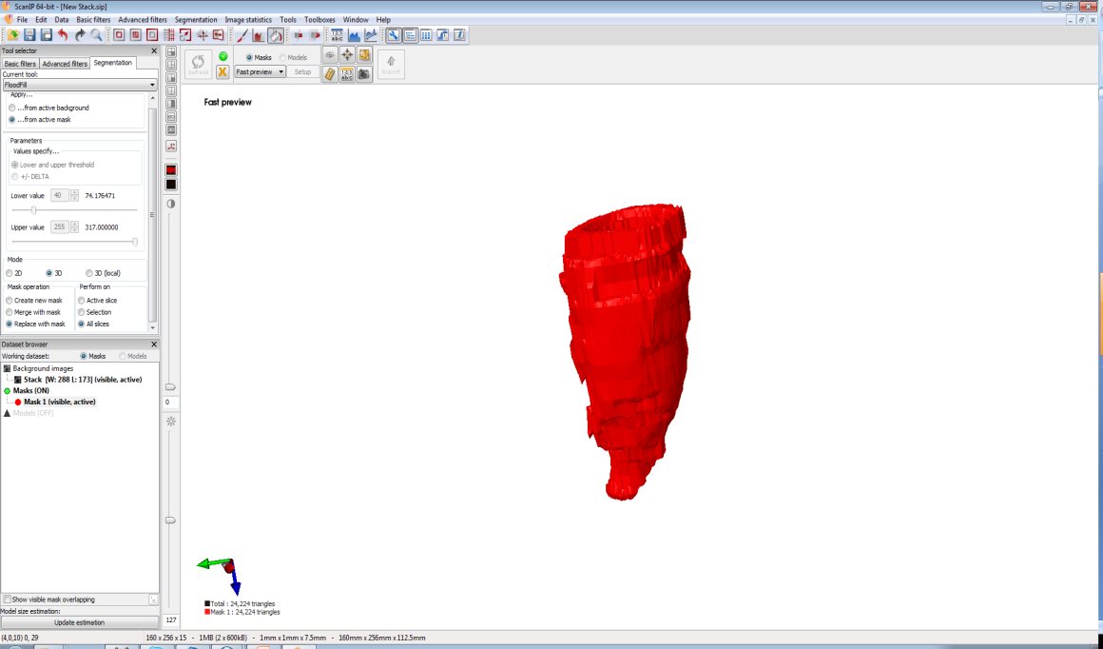
1) Segmenting the data
The main problem with this data is that the slice distance is big. I am assuming that it is the same scale as the ScanIP file you sent previously, 1x1x7.5mm. A greater resolution in the Z direction would help the model... However there are some tricks to help make a good model here.
Rough segmentation using interactive threshold. Create a mask, select thresholding segmentation tool and ‘tick’ interactive. Drag the Lower and Upper values to ensure the area you want is mostly selected with as little extra area selected as possible.
b) Because there are so few slices I think the easiest way to remove the extra material is using the manual Paint. Ensure that it is set to ‘unpaint’ and ‘active slice’ and change the brush size to a suitable size for the image. Remove any area immediately touching the structure you want on all slices. Do not worry about removing the rest.
c) Use Floodfill segmentation tool, ensure ‘..from active mask’, ‘Replace with mask’ and ‘All slices’ are selected, then click on the area you want to keep.

Slide 3
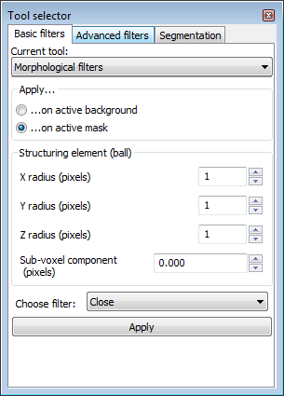
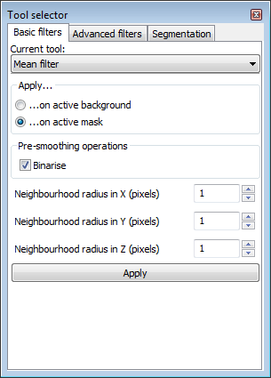
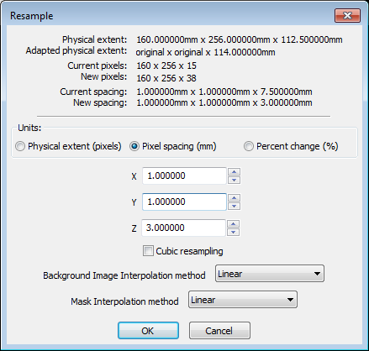
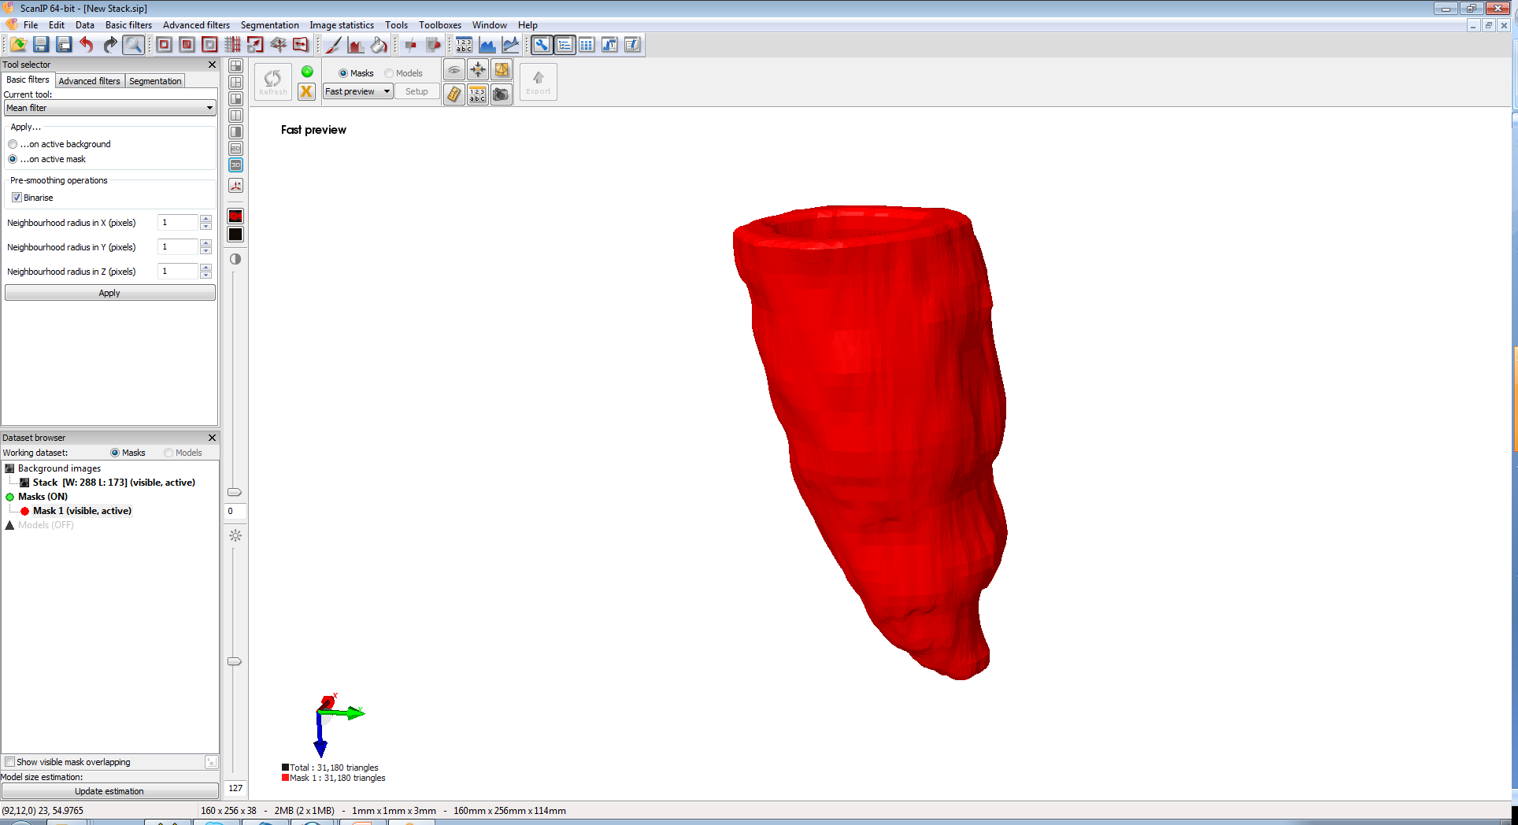
3) Improving the model
At this point the model is rough, to make it smooth and nice the following things should be done.
Resample: to even out the in and out the voxel sizes. Go to Data->Resample and change the Z distance to 3 (this was my choice you can chose another number if you like). Ensure the interpolation methods are both ‘Linear’.
Use the Morphological filter in the Basic Filters tab. Select ‘Close’ and 1x1x1 on ‘Active mask’. This will heal any small holes in the segmentation.
Smooth the model using the Mean filter. Binarize and use 1x1x1. This filter can change the segmentation and should not be over used, however the Mean filter is the least likely to alter the shape. Be careful to check that holes do not appear following its application if the segmented edge is thin, your model seems to be particularly prone to this. If they do then look at the images in all 3 directions and use the paint tool to carefully fill the gap.

Slide 4
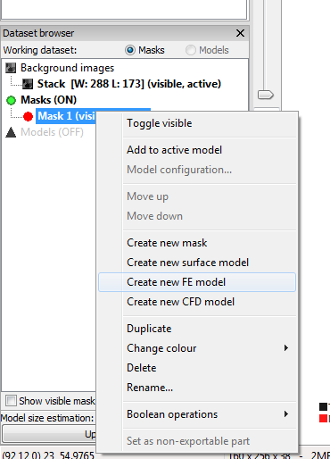
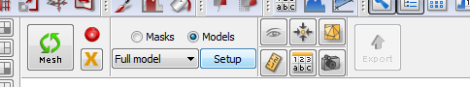
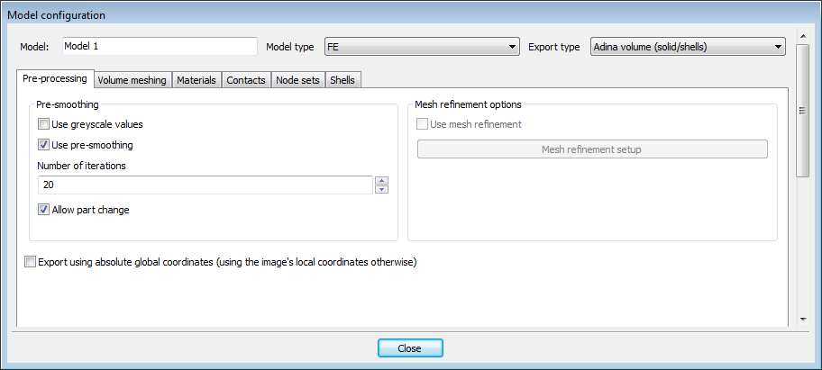
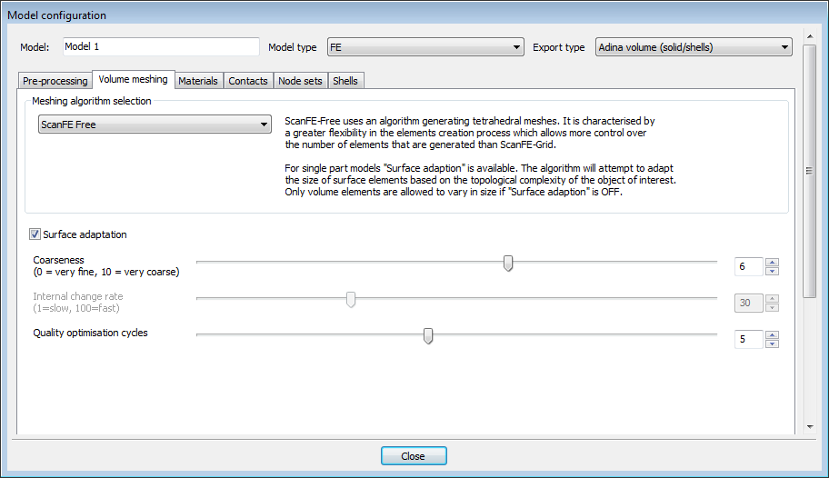
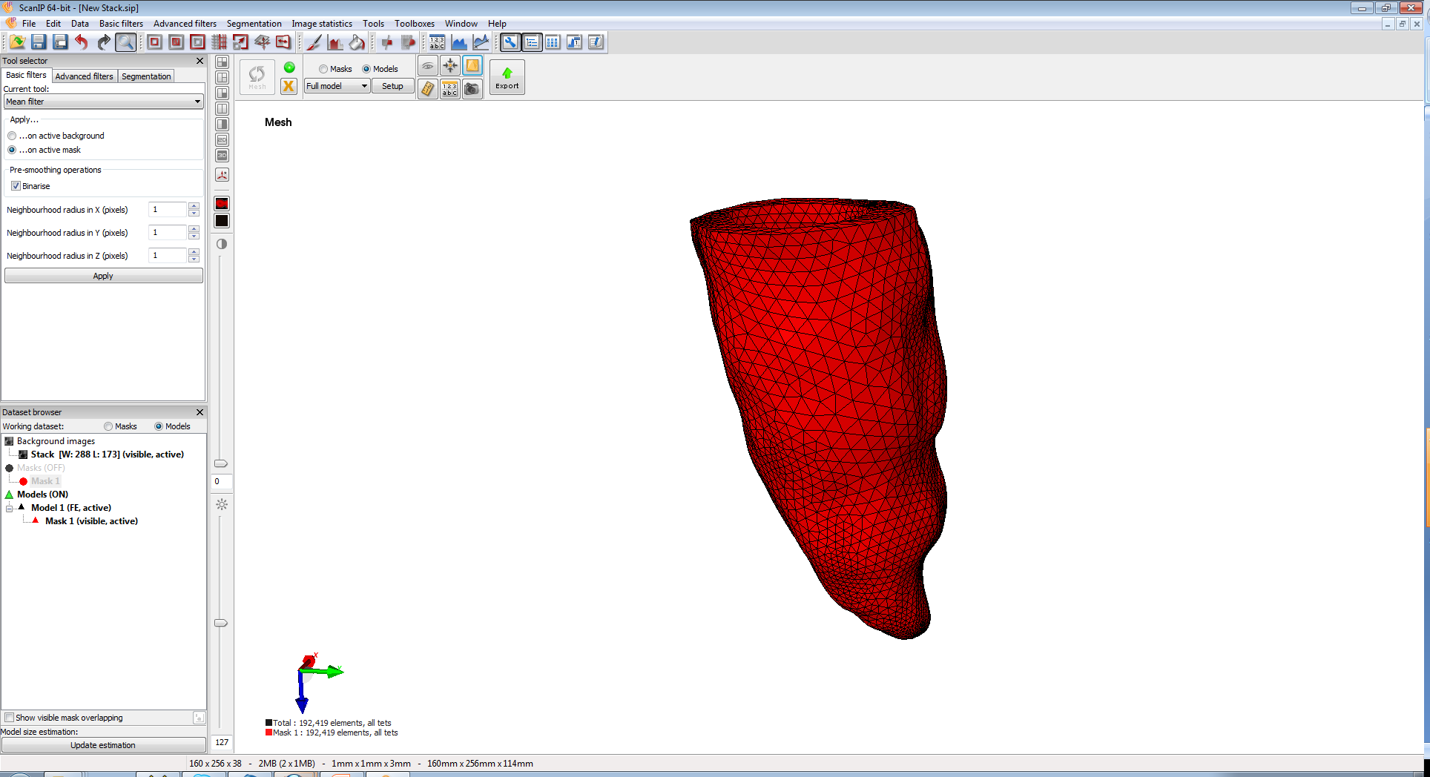
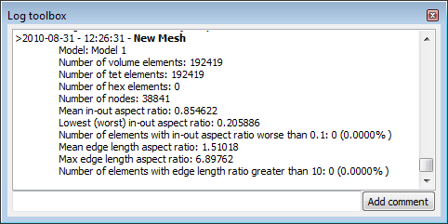
3) Meshing the model
Firstly create a model by right clicking on the mask in the Dataset browser and selecting ‘Create new FE model’ then drag an drop the mask into the ‘Model 1(FE)’.
Above the 3D view window change from Fast Preview to Full Model and click ‘Setup’.
Set up the model as below. With type ‘FE’, Export type ‘Adina’ if that is what you are using for your analysis. I suggest using the ScanFE free meshing algorithm as for this single part model you can use the surface adaption option to control the number of elements to suit your model very effectively.
Click ‘Mesh’. The Log toolbox will give you a range of statistics about the model, including the number of nodes and elements and information about the element qualities. As you can see this model has come out with excellent qualities. The mesh can be adjusted by changing the meshing parameters.

